Slide 1
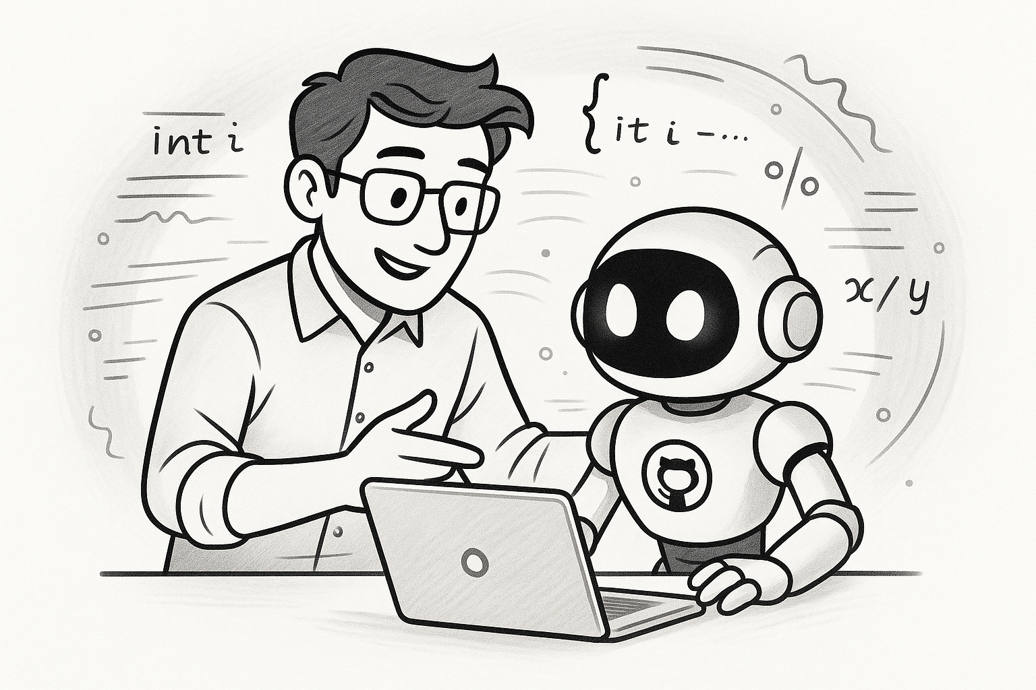
GitHub Copilot In Action
Collaborating with AI for Success

Slide 2
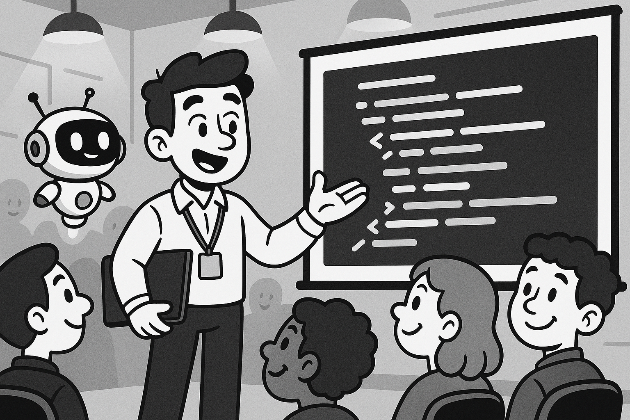
Audience
I want to work with copilot but don’t know where and how to begin.
Don’t understand how copilot can help.
Need to see GitHub Copilot in action rather than theory

Slide 3
Presentation Format
CONCEPTS
APP WALKTHROUGH
Real App Walkthrough
Getting Started
Walkthrough of Copilot
  Documentation
  Analysis & Design
  Tips and Tricks
  Pitfalls to avoid
Fundamentals
Instructions
Prompts
How Tokenization Works
Copilot Context Management

Slide 4

Valid Concerns:
Trust & Quality Control.
Learning Inhibitions.
Security & Intellectual Property Concerns.
Cultural & Social Resistance:
Positive Counter-Evidence:
90% higher job fulfillment when adopted
95% enjoy coding more with Copilot
8.69% increased throughput (pull requests)
84% increase in successful builds
15% higher PR merge rates

Slide 5
INSTRUCTIONS
PROMPTS
Copilot’s Script
How to think about a specific task.
  How to Write documentation
  Describes approval steps before code is written
  Outlines style rules for writing text or generating diagrams
Copilot’s Rulebook
Does not contain code
Contains GUIDANCE!
Sets
  Tone (concise, formal, etc.)
  Boundaries
  Workflow Expectations
it’s not programming—it is instructions written in plain English that Copilot reads to know how to operate within your team.
“Prompts are reusable instructions. Instead of repeating ourselves every time, we teach Copilot once and it applies the instructions consistently.”

Slide 6
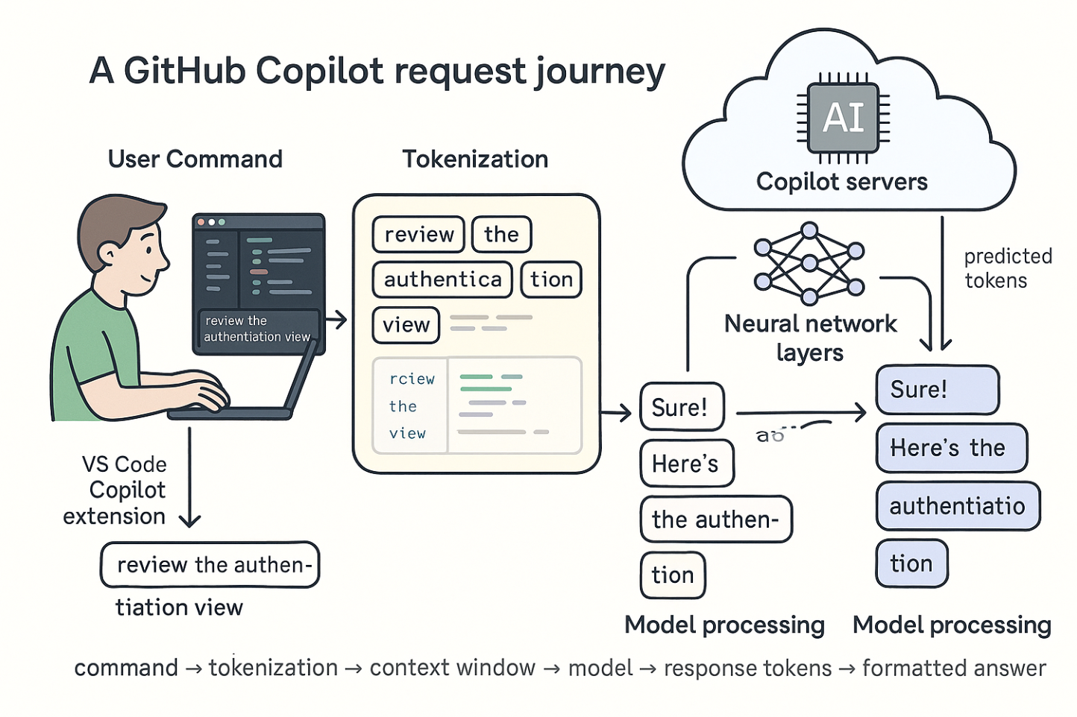
TOKENS ??

Slide 7
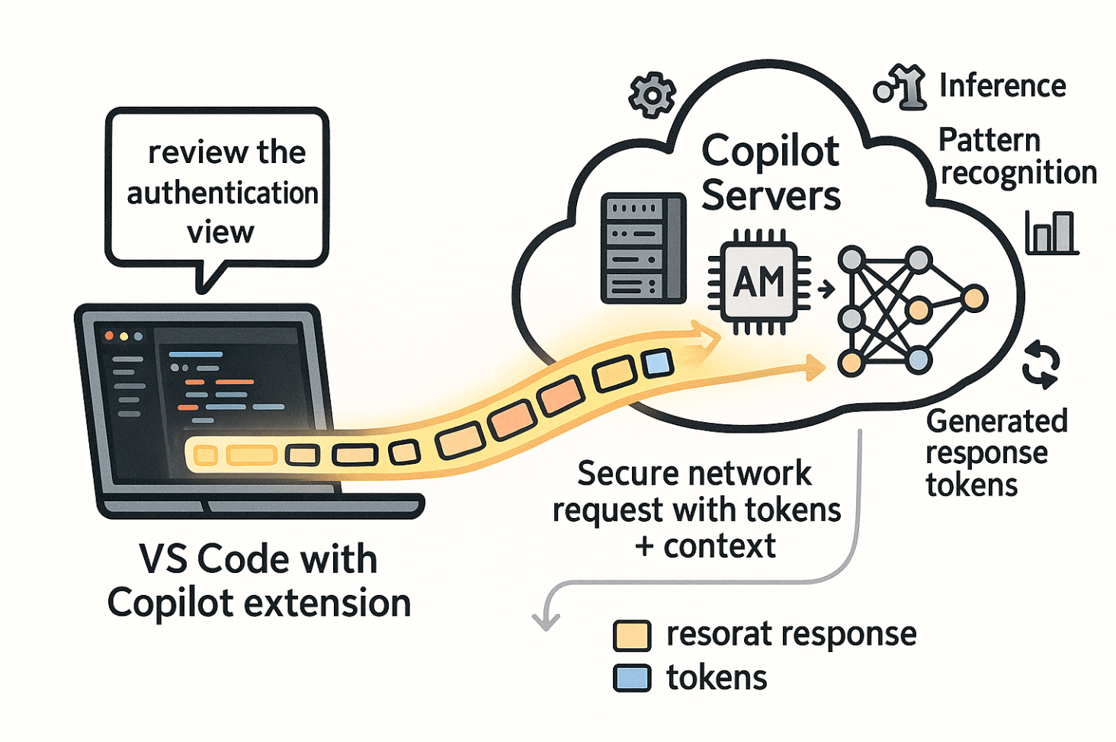
NUTSHELL
Text is broken into tokens (words, parts of words, punctuation, code symbols)
Average ~4 characters per token in English, less in code due to special characters
General Token budget for a session: 1,000,000 tokens
Both input (your prompts) and output (Copilot responses) consume tokens

Slide 8
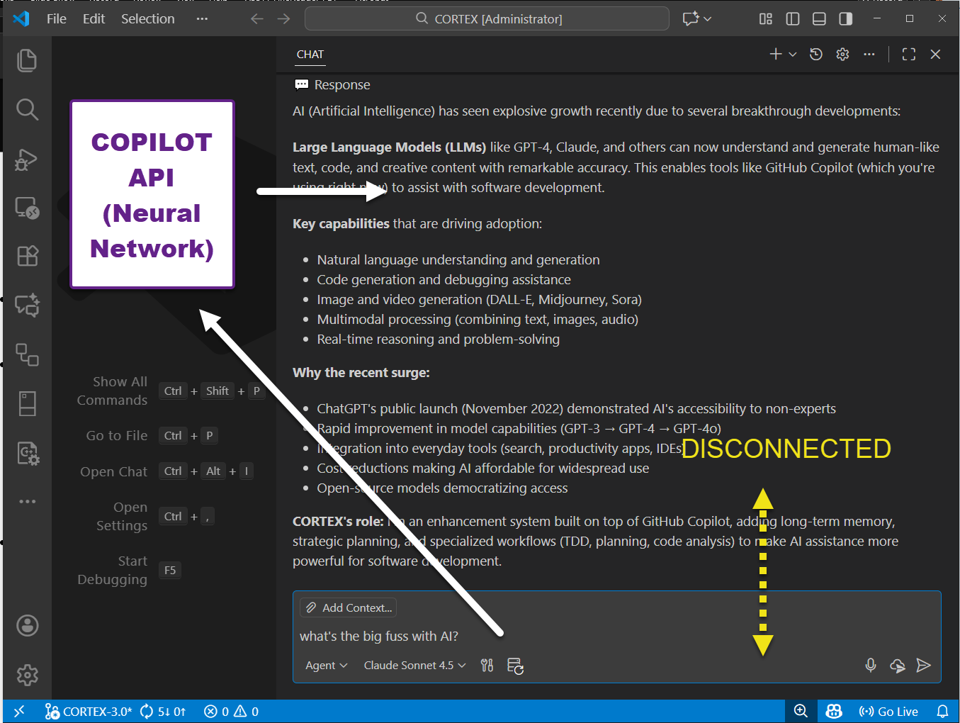
COPILOT CONTEXT
VS Code Copilot has no persistent memory
Context = whatever the extension sends along with your request
  Explicit Prompt
  File Content
  Surrounding Code
  Workspace Context
  Special System Instructions
Server-side context handling
  The model receives the full tokenized prompt.
  Tokens load into the model’s context window—basically RAM for the model.
  Attention layers compute relationships across all tokens.
  Predictions are generated token-by-token.
  Response tokens get streamed back to VS Code.
Why Copilot “remembers” things only for a few turns

Slide 9
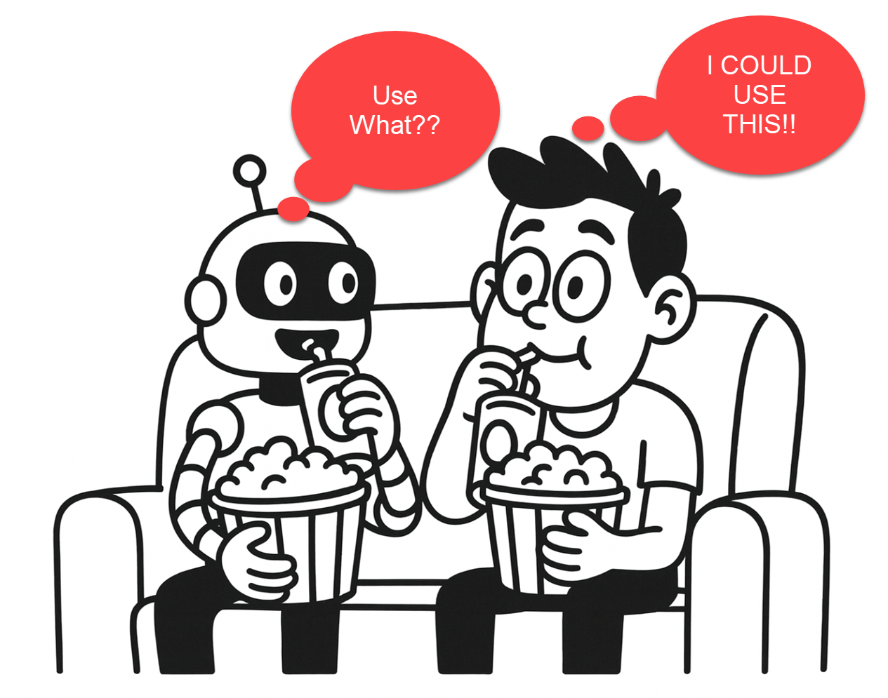
RELAX & ENJOY & IMAGINE

Slide 10
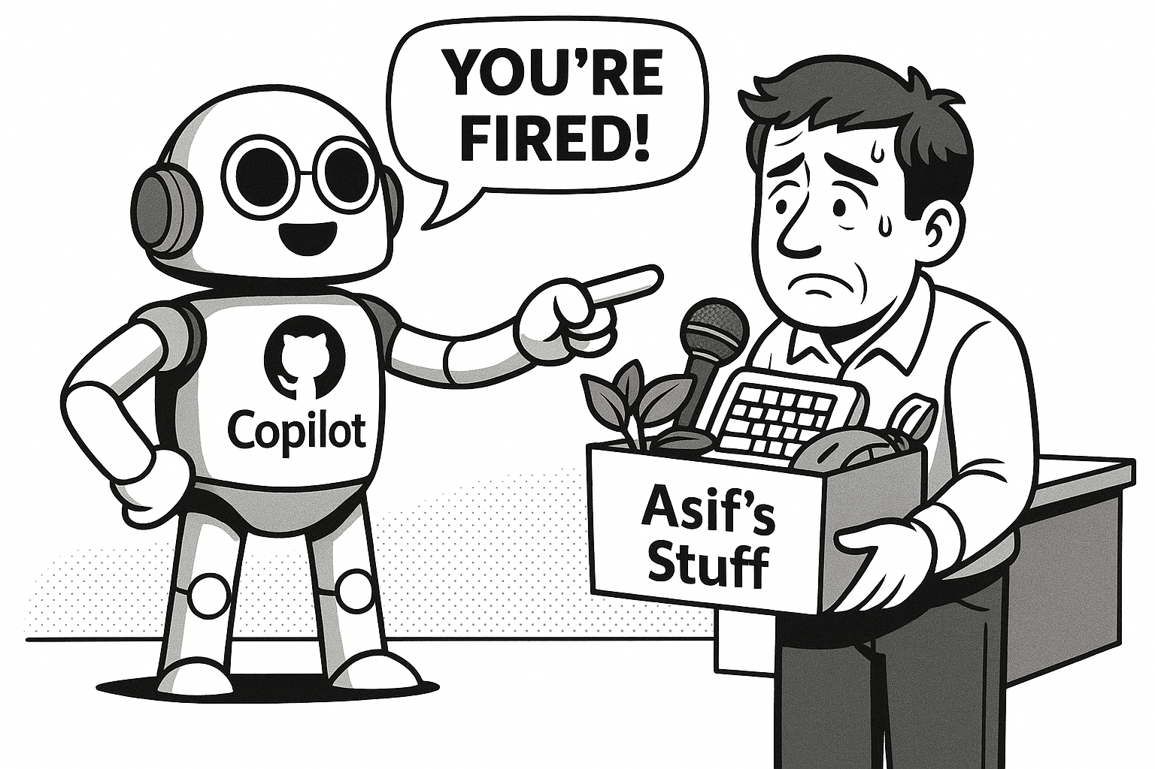
Will Copilot replace me?

Slide 11

Takeaway
Don’t FEAR, Copilot is HERE!
Paradigm Shift
YOU are in CONTROL.

Slide 12
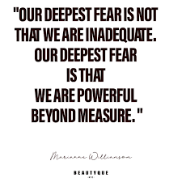

Slide 13
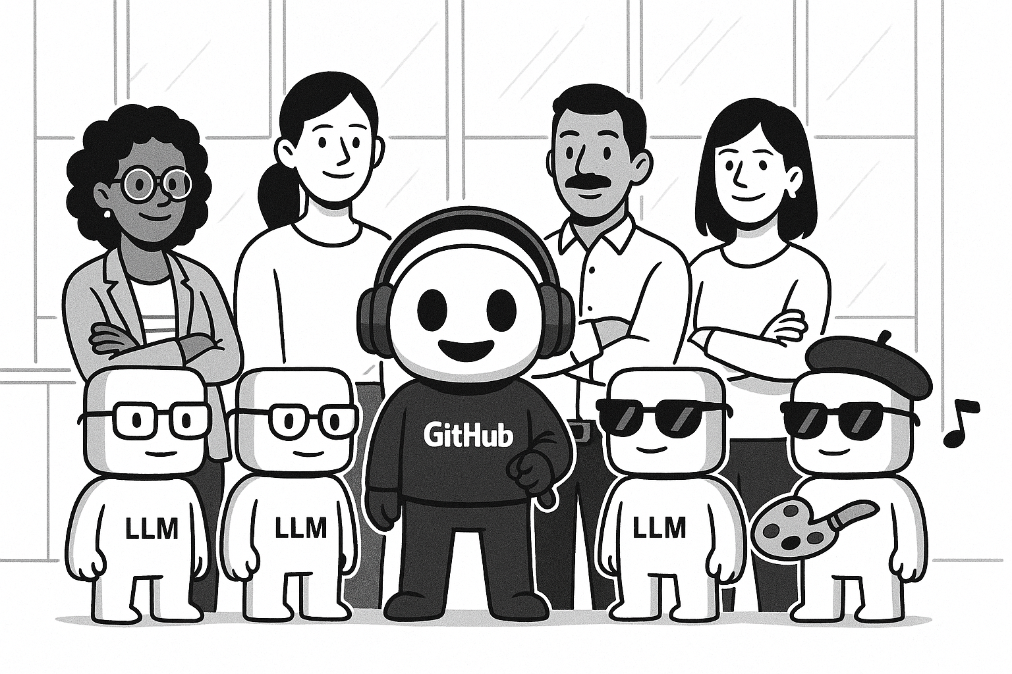
Happy Copiloting!!

